Slide 1
Control Statement
Presented by Jamil Rayhan
ID:18CSE061

Slide 2
What are control statement?
The control statements allows developers to control the flow of program’s execution based upon some conditions during run time.
It allows developers to:
Repetitive execution of statements.
Conditional execution of statements.

Slide 3
Categories
Control Statement
Selection
Iteration
Jump
if
break
return
switch
do
while
continue
if-else
for

Slide 4
Selection Statement
Selection statements allow the program to choose different paths of execution based upon the outcome of an conditional expression or state of variable.
Java supports the following selection statements
if else statement
switch statement

Slide 5
If statement
The IF statement is a decision-making statement that guides a program to make decisions based on specified criteria.
The IF statement executes one set of code if a specified condition is met (TRUE) or another set of code evaluates to FALSE.
If statements
Simple if
if-else
if-else ladder

Slide 6
Switch statement
Switch statement is a type of selection control mechanism.
Used to allow the value of a variable or expression to change the control flow of program execution via search and map.

Slide 7
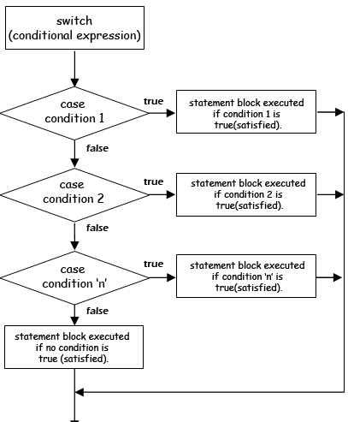
Exit

Slide 8
Iteration Statements
Iteration is when the same procedure is repeated multiple times.
The java programming language provides a set of iterative statements that are used to execute a statement or a block of statements repeatedly as long as the given condition is true.
The iterative statements are also known as looping statements or repetitive statements.

Slide 9
Iterations/Loops
Java got three types of loop:
While
Do while
For
Each loop has four types of statements
Initialization
Condition checking
Execution
Increment/Decrement

Slide 10
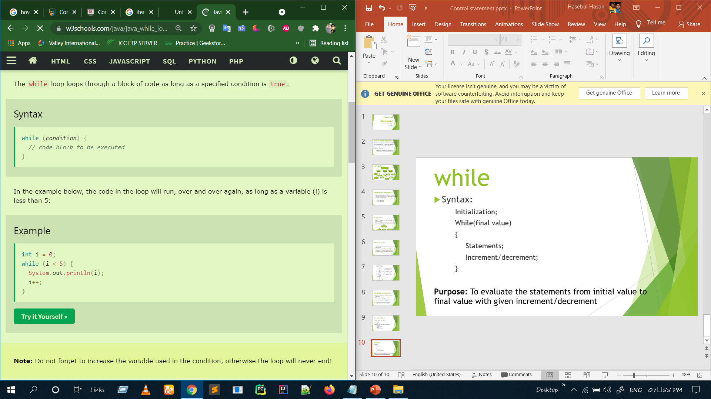
while
Syntax:
Initialization;
While(condition)
{
Statements;
Increment/decrement;
}
Purpose: To evaluate the statements from initial value to final value with given increment/decrement

Slide 11
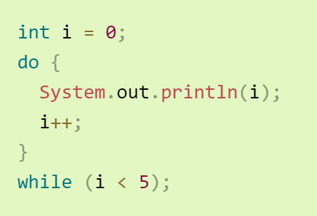
do while
Syntax
Initialization
Do
{
Statements;
Increments/decrements;
}
While(condition);
Purpose: To evaluate the statements from initial value to final value with given increment/decrement

Slide 12
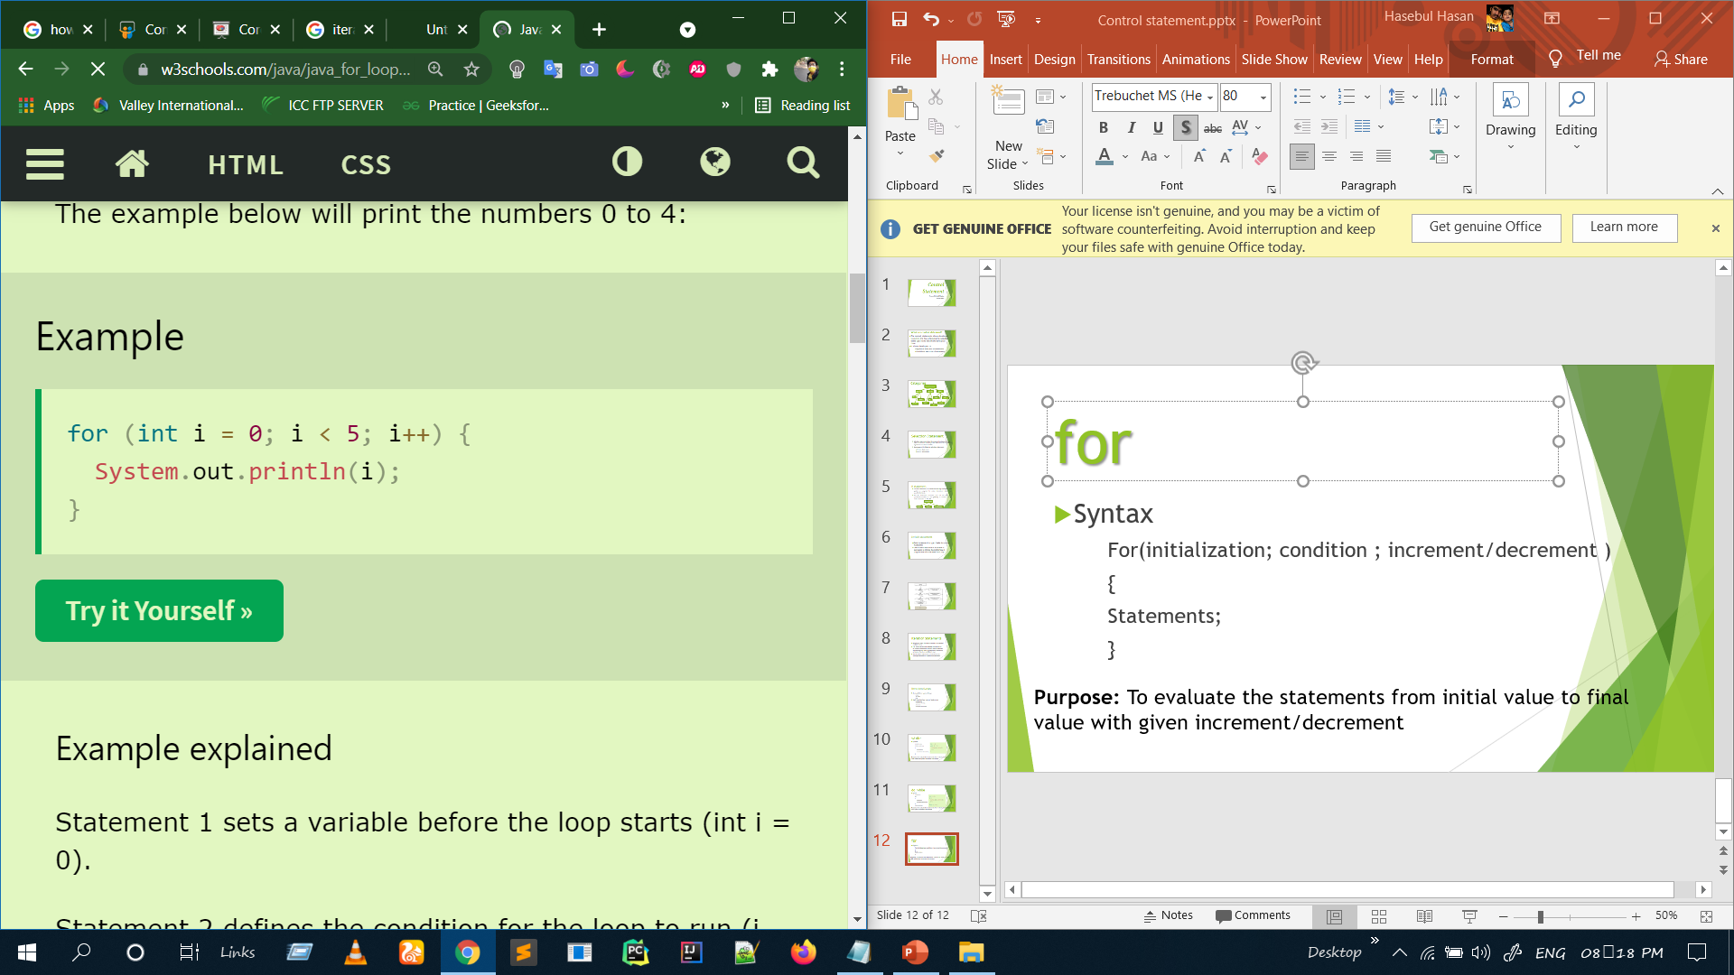
for
Syntax
For(initialization; condition ; increment/decrement )
{
Statements;
}
Purpose: To evaluate the statements from initial value to final value with given increment/decrement

Slide 13
Jump statements
Java supports three jump statement:
break
continue
return
These three statements transfer control to other part of the program

Slide 14
The Break Statement
This statement is used to jump out of a loop.
Brake statement was previously used in a switch –case statements.
The remaining statements which are after the brake and within the loop are skipped

Slide 15
Continue statement
This statement is used only with in looping statements.
When the continue statement is encountered, the next iteration starts.
The remaining statements in the loop are skipped. The execution starts from the top of loop again.

Slide 16
The return statement
This statement is used to explicitly return from method.
It causes program control to transfer back to the caller of the method.
The return statement immediately terminates the method in which it is executed.

Slide 17
Thank You

